Slide 1
Personality
Chapter 11 Sections 2, 3

Slide 2
The Trait Approach 11.2: Identifying Patterns of Behavior
Trait: a relatively stable disposition to behave in a particular and consistent way; described by Gordon Allport (1897-1967)
A trait may be a pre-existing disposition that causes the behavior (measured by personality inventories), or the motivation that guides the behavior (measured by projective tests).
How might traits explain behavior?
Notes:
Click to reveal bullets and question.

Slide 4
The Search for Core Traits
Traits can be classified by using adjectives (language), which may be organized in a hierarchical pattern.
Theories regarding the number of core traits vary Cattell-16 traits, Eysenck-3 traits)
Conscientiousness
Agreeableness
Neuroticism
Openness to experience
Extraversion
Big Five: the traits of a five-factor model:
Accounts for variability without overlap, converges around multiple types of data, and shows up across diverse populations (may be universal)
Can predict patterns of behavior that remain stable over time
Notes:
Click to reveal bullets.

Slide 5
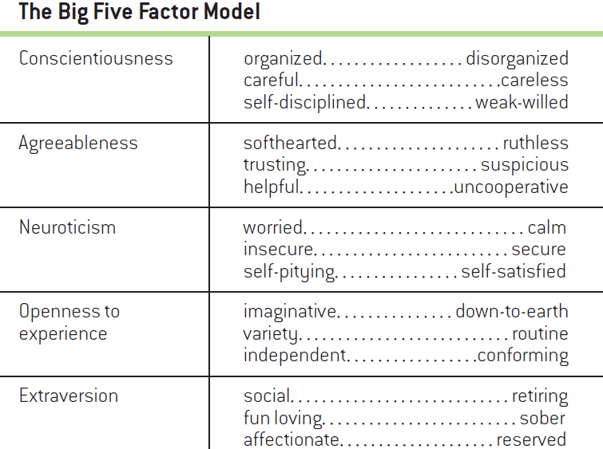
Table 11.1 The Big Five Factor Model
What are the strengths of the five-factor model?
Notes:
Click to reveal question.

Slide 6
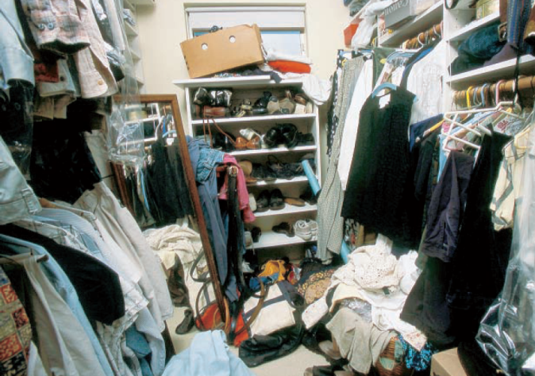
Personality on the Surface
Some valid personality judgments can be made from superficial cues.
In a study, participants made personality judgments of business office and dormitory room occupants based on the way the rooms looked.
Results showed their Big-Five estimations to be quite accurate.
Other studies link personality traits to music preference.
The way we outwardly express ourselves (appearance, personal social networking pages) projects our personalities.
Notes:
Click to reveal bullets.

Slide 7
Traits as Biological Building Blocks
Brain damage and pharmaceutical treatments may causes changes in personality.
Behavioral genetics looks for differences between monozygotic and dizygotic twins reared together and reared apart.
The greater similarity in personality, the greater the overlap in genes.
What do studies of twins tell us about personality?
Notes:
Click to reveal bullets and question.

Slide 8
Do Different Genders Lead to Different Personalities?
Research has shown some reliable differences in traits between men and women.
Some conform to North American gender stereotypes.
Other traits show no differences.
The evolutionary biological perspective holds that men and women have evolved different personality traits because reproductive success depends on different behaviors.
The social cognitive perspective (social role theory) argues that differences between men and women result from cultural standards and expectations.
Bem Sex Role Inventory: being psychologically androgynous can be beneficial; more beneficial for women
Men and women may be more alike in personality than different.
Notes:
Click to reveal bullets.

Slide 9
Traits in the Brain
Hans Eysenck (1916-1997) postulated that extraversion and introversion may arise from individual differences in alertness.
Jeffrey Gray (1934-2004) proposed two brain systems responsible for extraversion and neuroticism.
Behavioral activation system (BAS): the “go” system
Behavioral inhibition system (BIS): the “stop” system
What neurological differences explain why extraverts pursue more stimulation than introverts?
Notes:
Click to reveal bullets and question.

Slide 10
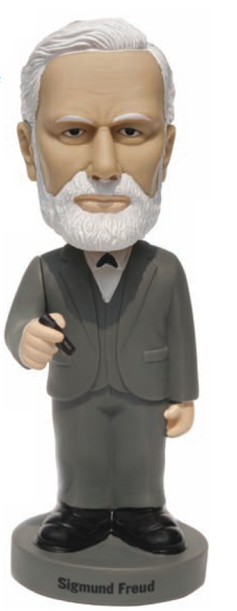
The Psychodynamic Approach: Forces That Lie Beneath Awareness
Psychodynamic approach: an approach that regards personality as formed by needs, strivings, and desires largely operating outside of awareness—motives that can also produce emotional disorders; developed by Freud

Slide 11
The Structure of the Mind: Id, Ego, and Superego
Freud proposed that the mind consists of three independent, interacting, and often conflicting systems that determine the personality’s structure:
Id
the part of the mind containing the drives present at birth; the source of our bodily needs, wants, desires, and impulses, particularly our sexual and aggressive drives
Ego
the component of personality, developed through contact with the external world, that enables us to deal with life’s practical demands
Superego
the mental system that reflects the internalization of cultural rules, mainly learned as parents exercise their authority
Notes:
Click to reveal id, ego and superego boxes.

Slide 12
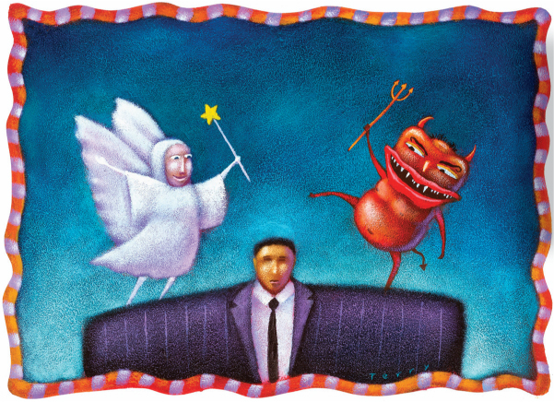
How is personality shaped by the interaction of the id, ego, and superego?
Notes:
Click to reveal question.

Slide 13
Dealing with Inner Conflict http://www.youtube.com/watch?v=feZjLymV1gQ&safety_mode=true&persist_safety_mode=1
Conflict between the id, ego, and superego causes anxiety.
Defense mechanisms: unconscious coping mechanisms that reduce the anxiety generated by threats from unacceptable impulses
Supplying a reasonable-sounding explanation for unacceptable feelings and behavior to conceal one’s underlying motives or feelings
Rationalization
Reaction formation
Unconsciously replacing threatening inner wishes and fantasies with an exaggerated version of their opposite
Projection
Attributing one’s own threatening feelings, motives, or impulses to another person or group
The ego deals with internal conflict and perceived threat by reverting to an immature behavior or earlier stage of development
Regression
Displacement
Shifting unacceptable wishes or drives to a neutral or less threatening alternative
Identification
Reduces feelings of threat and anxiety by enabling us unconsciously to take on the characteristics of another person who seems more powerful or able to cope
Sublimation
Channeling unacceptable sexual or aggressive drives into socially acceptable and culturally enhancing activities
Notes:
Click to reveal bullets. Click to reveal defense mechanisms, then click to reveal the definition of each.

Slide 14
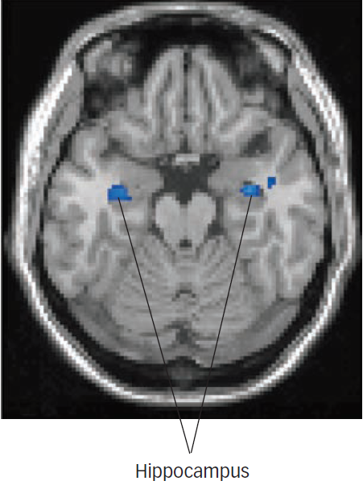
Figure 11.3 Decreased Hippocampal Activity During Memory Suppression

Slide 15
Psychosexual Stages and the Development of Personality
Psychosexual stages: distinct early life stages through which personality is formed as children experience sexual pleasures from specific body areas (erotogenic zone), and caregivers redirect or interfere with those pleasures
Oral stage
Phallic stage
Latency stage
Experience centers on the pleasures and frustrations associated with the mouth, sucking, and being fed (1st stage)
Dominated by the pleasure, conflict, and frustration associated with the phallic-genital region as well as coping with powerful incestuous feelings of love, hate, jealousy, and conflict (3rd stage)
Oedipus conflict: a developmental experience in which a child’s conflicting feelings toward the opposite-sex parent are usually resolved by identifying with the same-sex parent
Primary focus is on the further development of intellectual, creative, interpersonal, and athletic skills (4th stage)
Anal stage
Genital stage
Dominated by the pleasures and frustrations associated with the anus, retention and expulsion of feces and urine, and toilet training (2nd stage)
A time for coming together of the mature adult personality with a capacity to love, work, and relate to others in a mutually satisfying and reciprocal manner (5th and last stage)
Notes:
Click to reveal each stage.

Slide 16
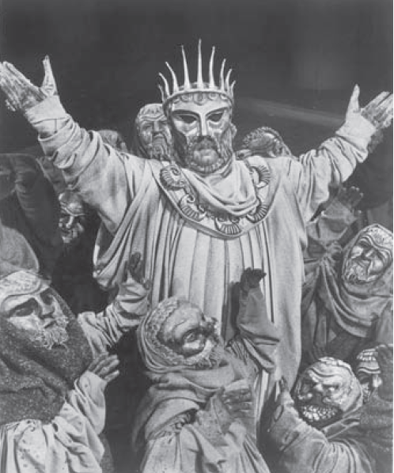
Why do critics say Freud’s psychosexual stages are more interpretation than explanation?

