Slide 1
Psychoanalysis
Monique Peterson
Guadalupe Araiza
Adrian Vega
Maurice Newton
Kajuan Johnson
Xavier Fondren

Slide 2
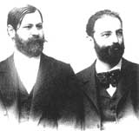
What is psychoanalysis?
It is theory aimed at making patients aware of their unconscious motives so as to gain control over their behavior.
Psychoanalysis also have a double identity.

Slide 3
Free Association
When a psychoanalysis tells someone to relax and talk about anything that comes to mind.
Free association is sometimes still used in psychological treatment today, though it is somewhat less common.

Slide 4
Dream Analysis
It is when you make a meaning to your dreams.
People with certain can unravel what your dreams really mean.
A dream analysis uses dreams through a
verbal description.

