Slide 1
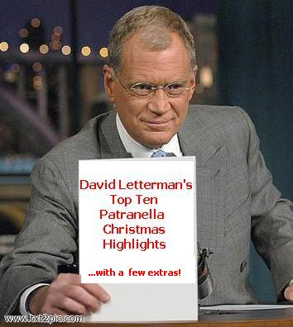
David Letterman’s Top Ten !

Slide 2
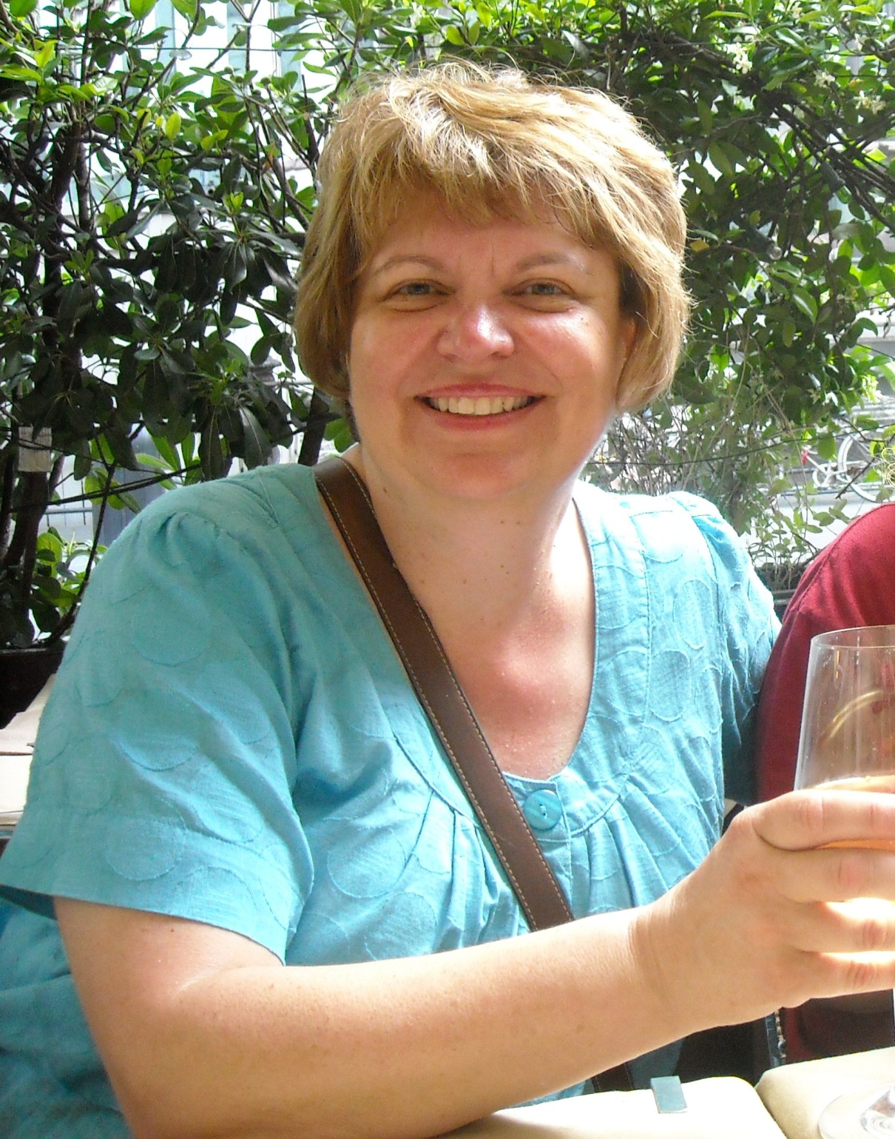
Mrs. Bowman’s Top Ten Reasons Why It’s Great to Teach Seniors!

Slide 3
10.

Slide 4
I get to read hundreds of papers this year !

Slide 5
9.

Slide 6
I get to see your baby/child pictures when I work on the senior bulletin board.

Slide 7
8.

Slide 8
I get to help with senior activities, and I’m the first to know who is on prom court.

Slide 9
7.

Slide 10
I get to read The Road and discuss it with you!

Slide 11
6.

Slide 12
Seniors know me, know ATA, know expectations.

Slide 13
5.

Slide 14
Seniors are more focused on being successful for graduation and college

Slide 15
4.

Slide 16
I get to see the improvement in your writing.

Slide 17
3.

Slide 18
I get to learn about you and relate to you on a more mature level.

Slide 19
2.

Slide 20
I get extra free time at the end of the year.

Slide 21
And the number one reason that it’s great to teach seniors:

Slide 22
I get to work with you--the class of 2011!!!!!

